Slide 1

Chandigarh Group of Colleges, Landran, Mohali
IBM Hack Challenge 2k18

Slide 2
Topic: Help me with my Mood

Slide 3
Team Members : ISHFAQ AHMAD BHAT MOHIT GUPTA
Team Name: Bug hunter

Slide 4

MAIN AGENDA
A person’s emotions and moods have direct bearings on his/her daily activities. It is necessary to eliminate negative emotions that our family or friends might be experiencing, to help them lead A better life. So to help them with this and detect their mood so as to help them with changing in it and give them better options so that one can change his/her mood. It can be done by using webcam and detect one’s facial expressions to conclude what all the are undergoing with and help them with changing their mood according to their mood. Which will finally help one to remain happy whole day and do all their daily work with perfection and happiness.

Slide 5
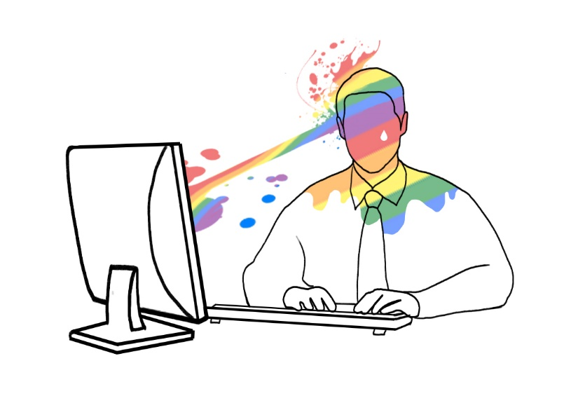

WORKING
In this project we are going to use facial landmarks of A person to detect emotions. So that our software can detect his/her emotions and after concluding about so can suggest him different activities which can be done to change his mood.
In this we will also use auenthication to acess data from various social networking of user such as Facebook,Instagram,You Tube and also playlist so that we can evaluate all the searches and type of data being posted by user and detect the mood he might be having as Nowdays everyone is very much active on social media platfroms and one can easily evaluate about person’s mood with help of them.

Slide 6

WORKING
Now when A person with use our software to scan his face using his webcam. As soon as he does so it will be shown that which emotion is the most detected emotion on his face.
All the emotions that can be on one’s face and the one with highest percentage would be marked in bold.

Slide 7


As one’s mood is now detected now all the facial expressions showing different emotions would be displayed and calculated according percentage of each and every emotion present on user’s face. Now according to the mood of person their will be a dropdown containing various activities which can be done by user so as to change the mood and user can change the mood according to the activity he can done so that mood can be changed and he spends his day very well so that remains happy and spread happiness among others too.

Slide 8
Now on the basis all the emotions their will be a some options to choose from so that one can do various activities so that one can choose from them and change their mood.
Their will be some different options that a person can do to change the mood such as-
Watch Movie
Go to Sleep
Listen Music
Call Someone
Have some food
Go for shopping

Slide 9


CONCLUSION
So at last our software will help one to detect his mood and all the actiivtis that can be done so that his mood changes and can be happy and spread happiness as this is very important in everyone’s life.
Happiness is a choice.
Be happy and spread happiness.

Slide 10


